Slide 1
Buying House Management System

Slide 2

Presented To:
Engr. A.S.M. Shakil Ahamed
Senior Lecturer

Slide 3
Team Members
ID | Name
Naimur Rashid Bhuiyan | 21303169
Maliha Anjum | 22203013
Israt Jahan Tithi | 22203035
Amit Roy | 22303227

Slide 4
Introduction
- Overview of Friends Fashion LTD
- Mission and Vision
- Target Audience
- Business Objectives

Slide 5
Sign In
- Secure login system
- User authentication
- Password recovery options
- Session management

Slide 6
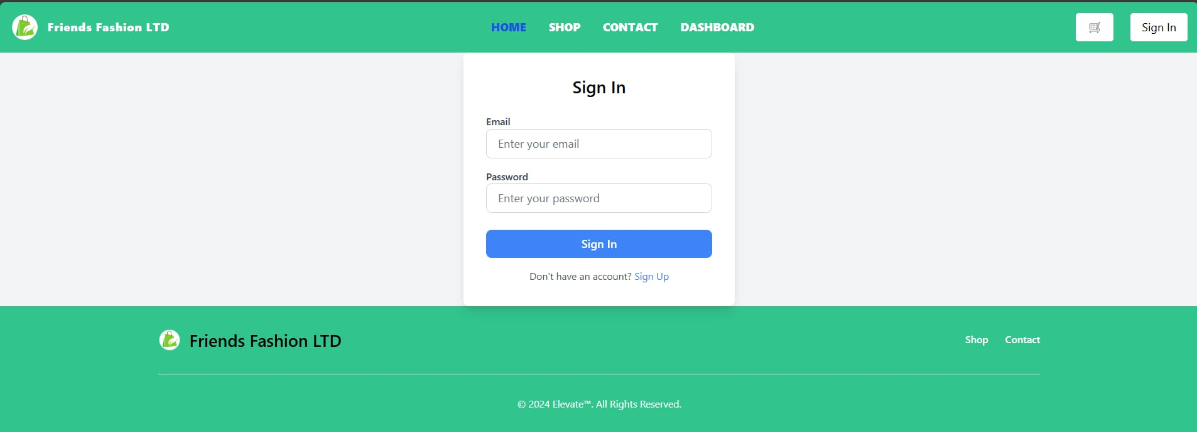

Slide 7
Your Cart
- Add and remove items
- View selected products
- Apply discounts or coupons
- Proceed to checkout

Slide 8
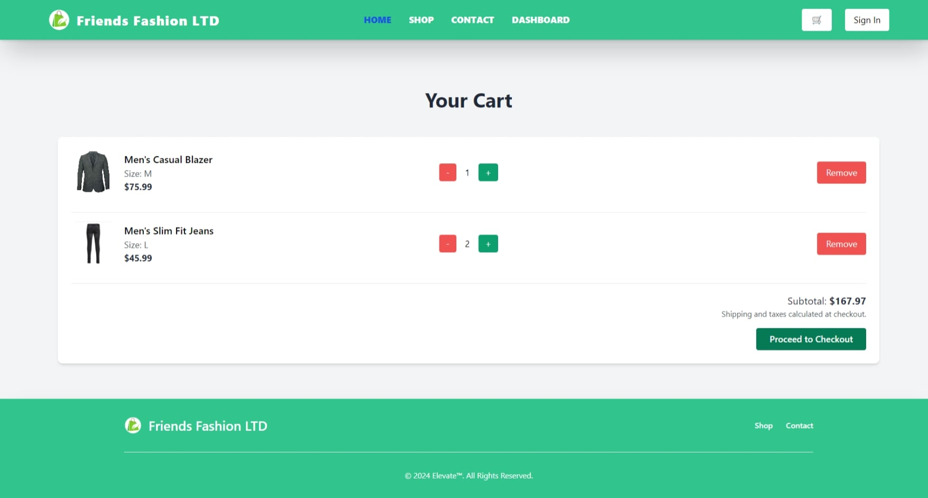

Slide 9
User Management
- User registration and profiles
- Manage user roles and permissions
- Track user activity
- Handle user feedback

Slide 10
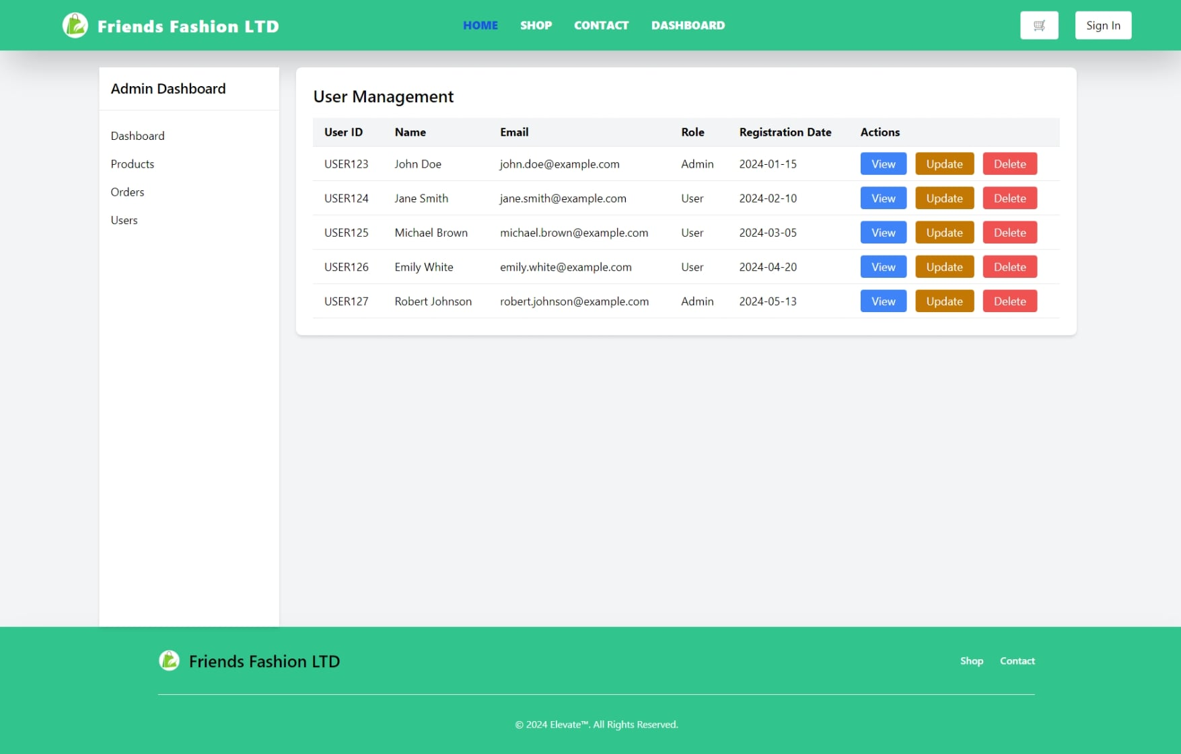

Slide 11
Order Management
- Track orders in real-time
- Order history and details
- Cancel or modify orders
- Automated order confirmations

Slide 12
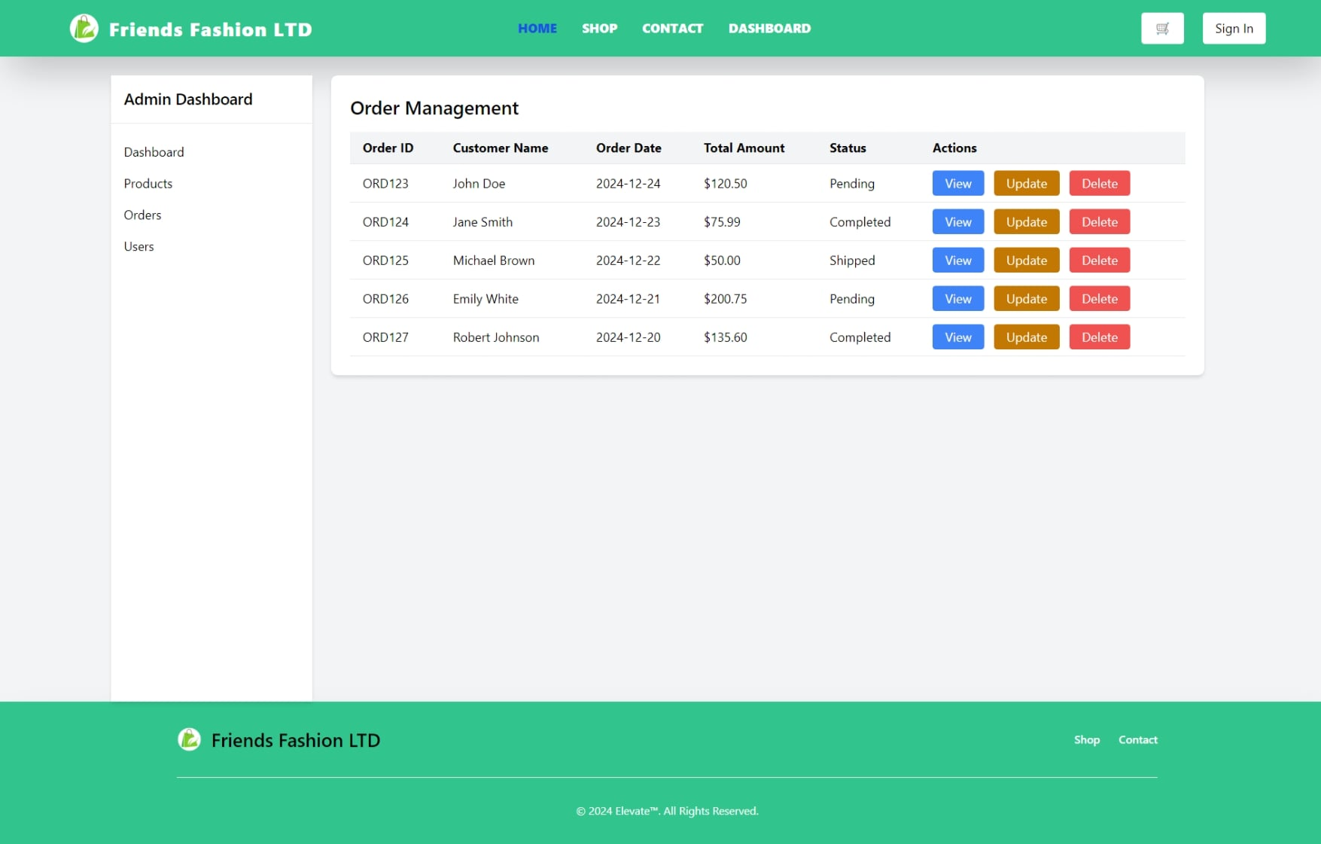

Slide 13
Product Management
- Add and update products
- Organize products into categories
- Manage product inventory
- Upload product images

Slide 14
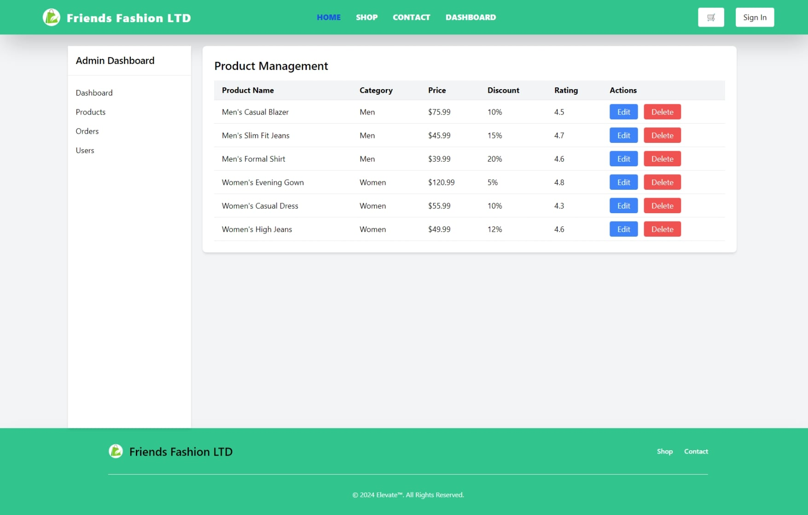

Slide 15
Admin Dashboard
- Overview of sales and performance
- Manage users and roles
- Generate detailed reports
- Monitor system activity

Slide 16
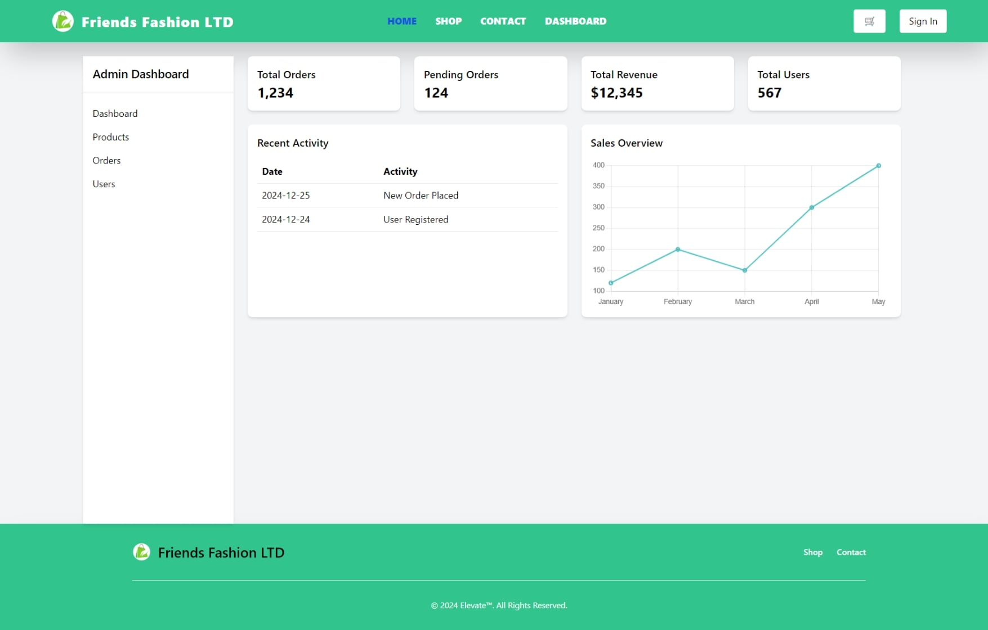

Slide 17
Contact Us
- Customer support information
- Feedback and inquiries
- Social media links
- Office location and hours

Slide 18
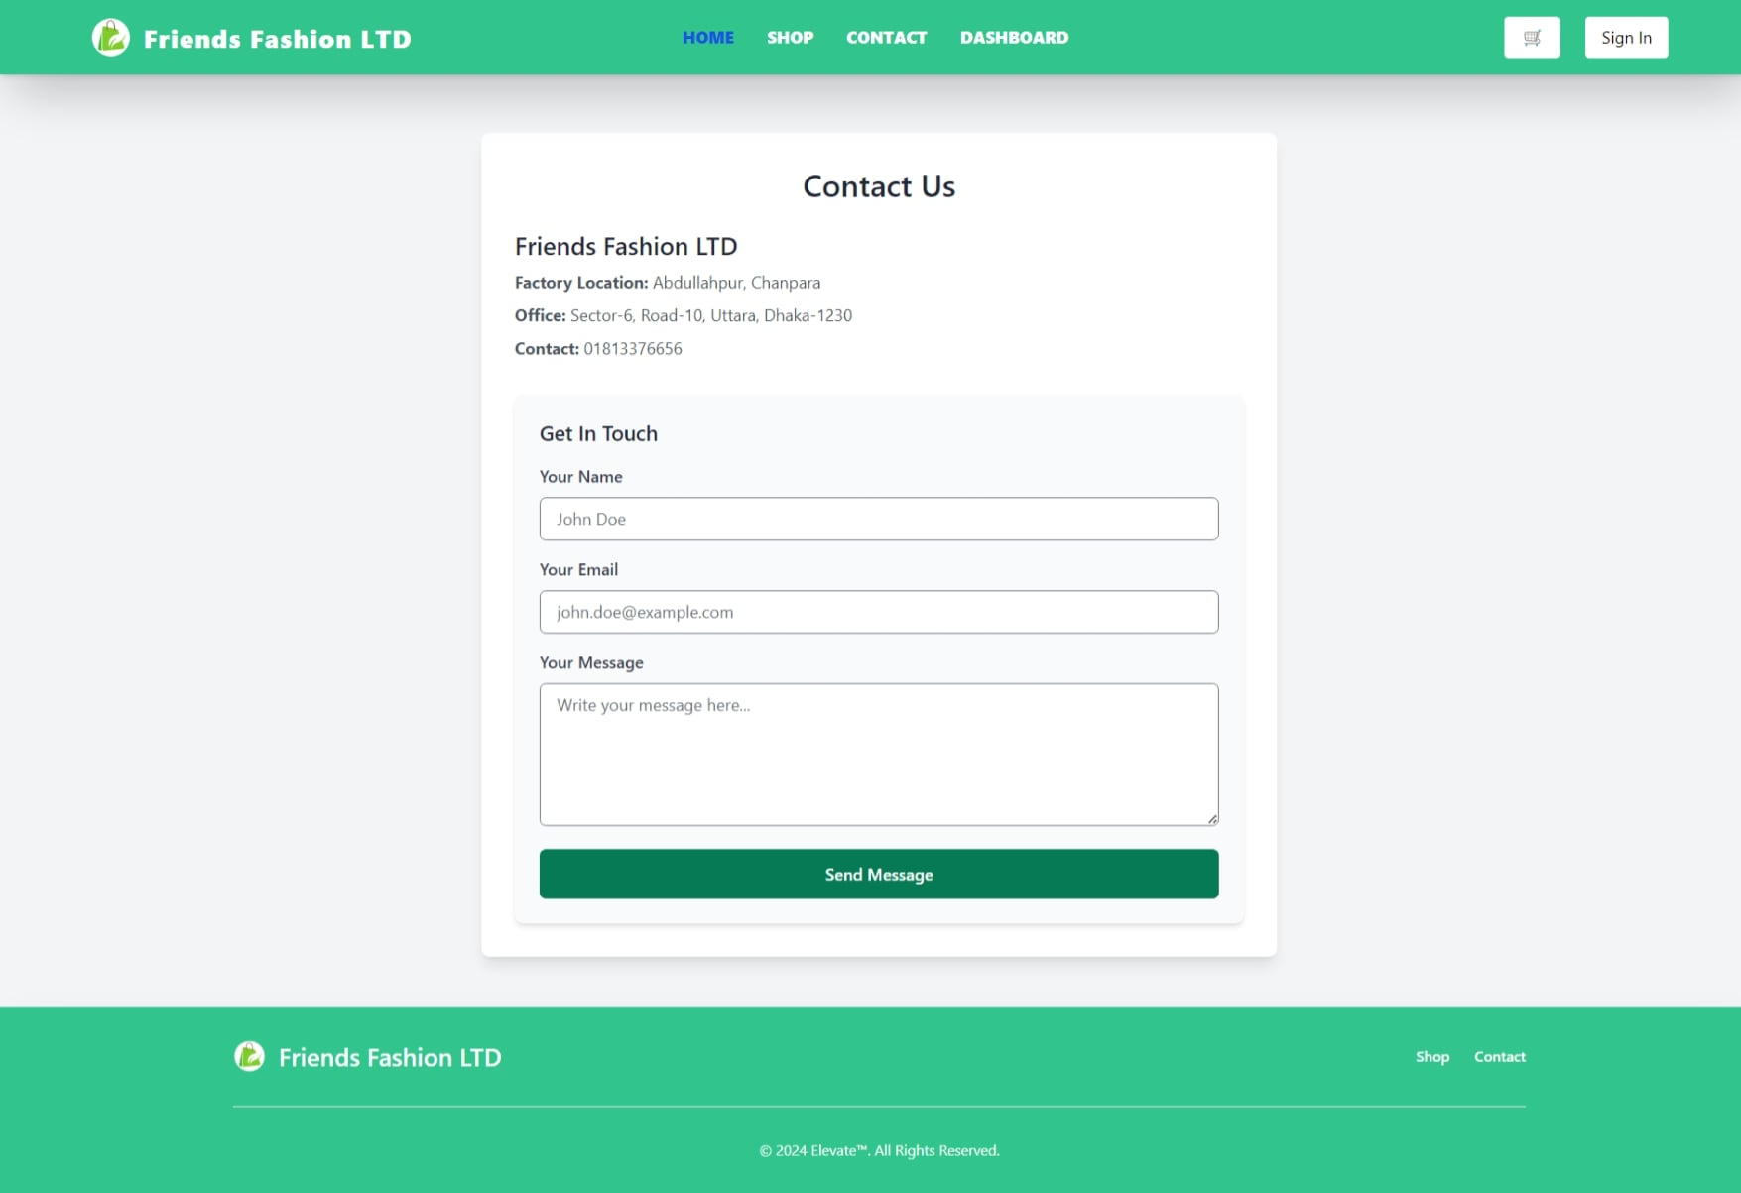

Slide 19
About Friends Fashion LTD
- Company history
- Core values
- Achievements and milestones
- Future goals

Slide 20
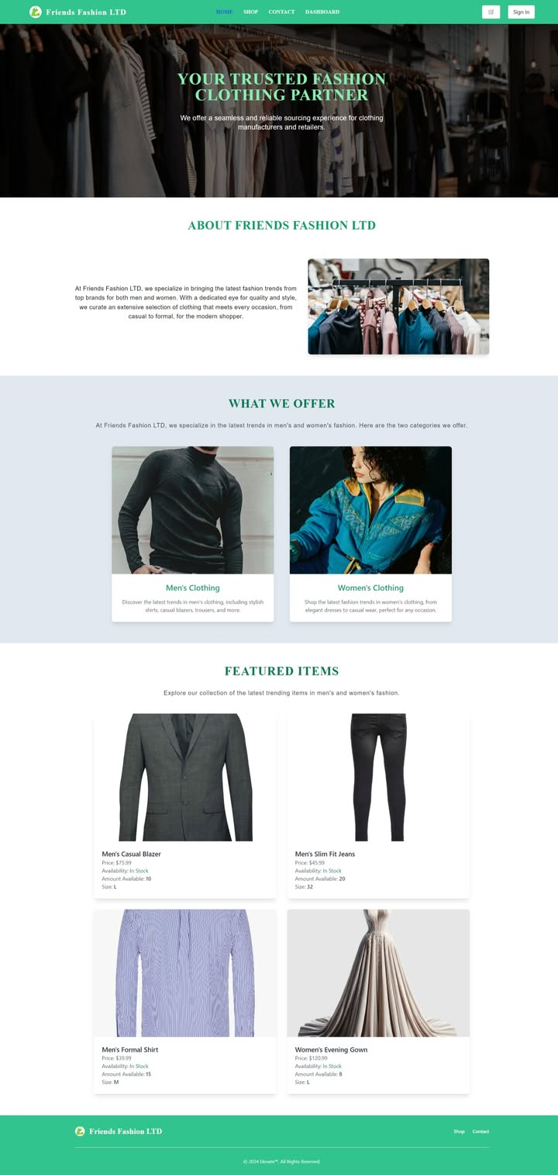

Slide 21
Our Product
- Range of products offered
- Unique selling points
- Quality assurance
- Customer testimonials

Slide 22
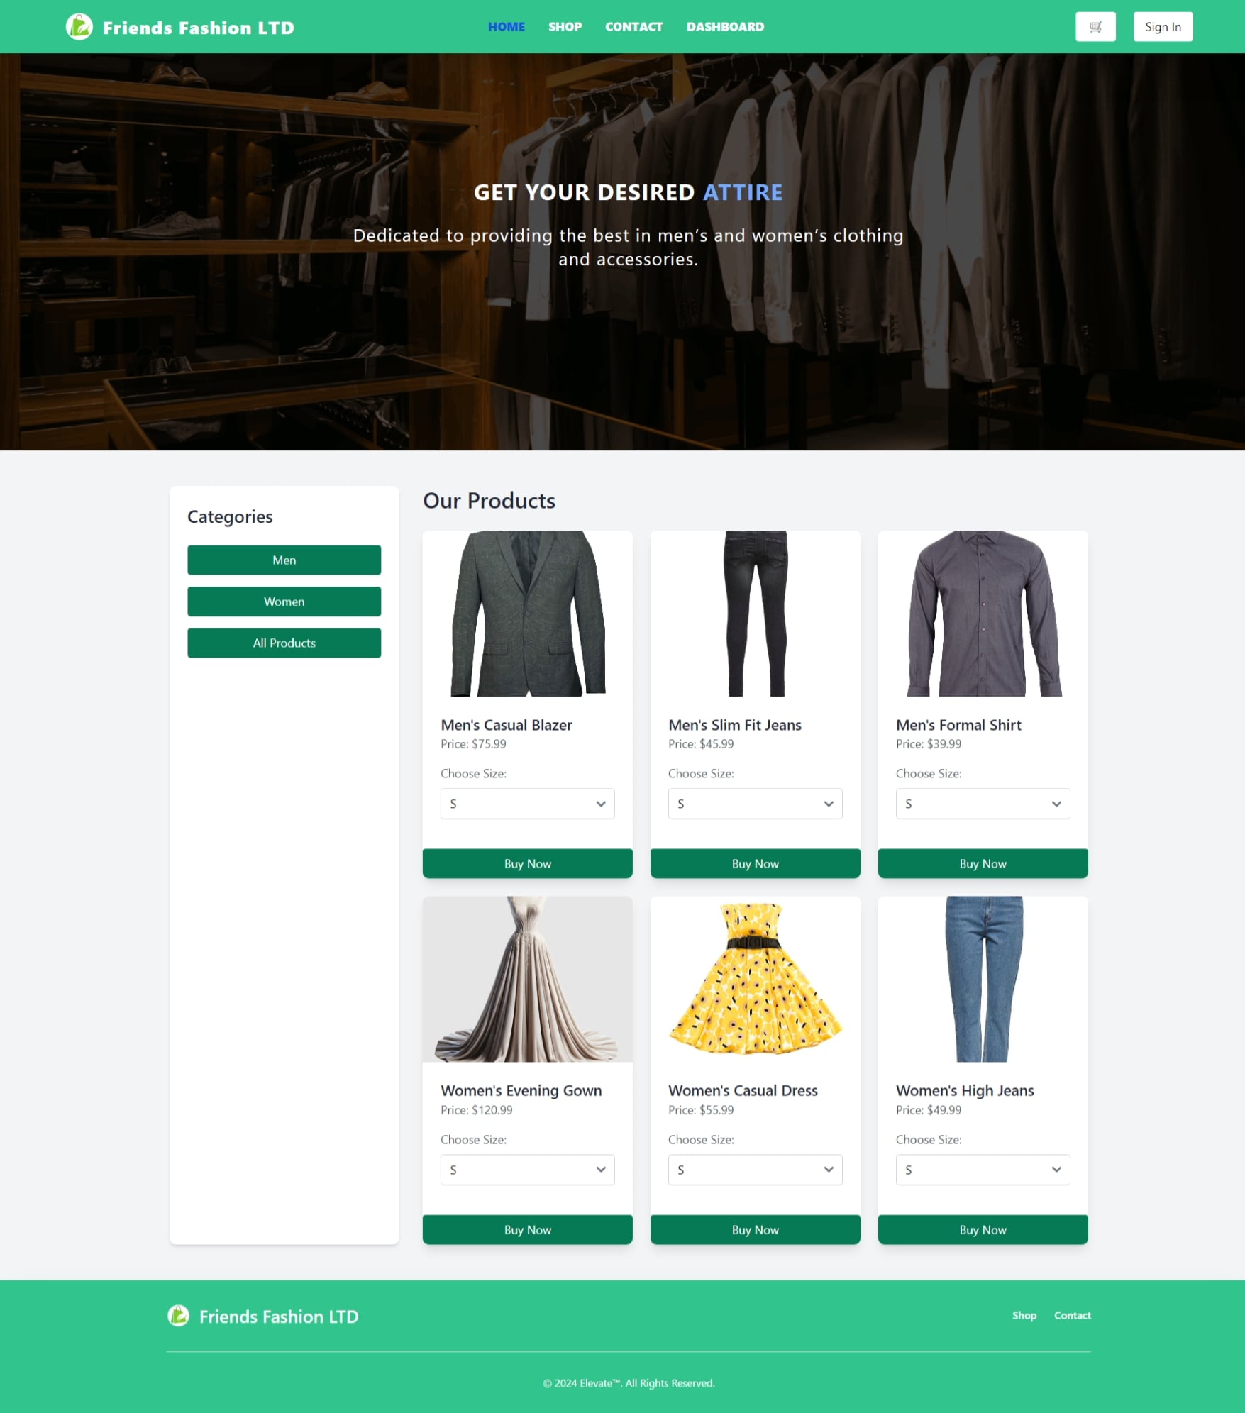

Slide 23
Conclusion In this project, we developed a comprehensive system for Friends Fashion LTD, addressing key functionalities such as user authentication, product management, and order processing. The system ensures a seamless shopping experience for customers and efficient management for administrators. By incorporating features like an admin dashboard and user management, the solution enhances operational efficiency. The project highlights the importance of robust system design in meeting user needs and achieving business objectives. Future enhancements could include advanced analytics and personalized user recommendations to further improve functionality.

Slide 24
Thank You

